Slide 1
Bus stop arriving Time Prediction
Oleg Shamray

Slide 2

Agenda
Main target of the project
Collecting Data
Preprocessing
Final Data Frame File
Modeling
Conclusion

Slide 3
Target of the project
Bus time prediction, is it possible? In this project we want to build our own model that will help us increase the accuracy of the bus arrival prediction time (hours and minutes given) for specific station.

Slide 4
Improved Collecting Data
At first, We pulled each XML file and saved it directly on our computer and started analyzing each one separately (this method took 2 much time than expected).
How we improved it?
We wrote an automatic code that pulls, transforming it into data frame, does first analyzation and appends it into a bigger and daily Data Frame.

Slide 5
The steps for getting Data Frame object in Python:
XML
Pulling xml file using http request every 15 sec.
Automatic Initial analyzation (appending chosen features into a one big daily data frame
EXCEL
Exporting the data frame as an excel file

Slide 6
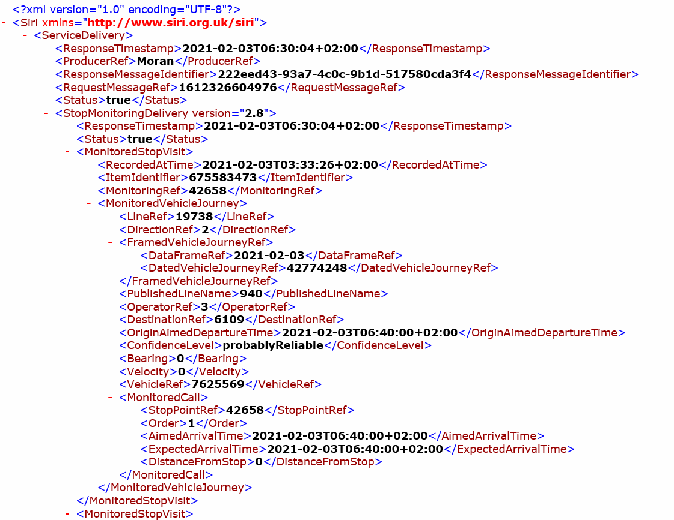
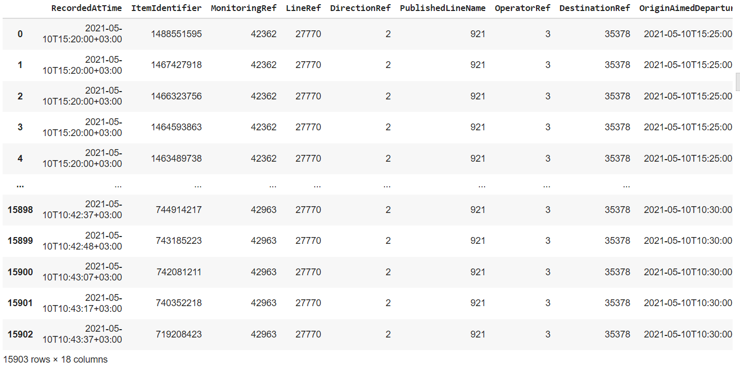

The steps for getting Data Frame object in Python:

Slide 7
Preprocessing
~16,000 ROWS
We reviewed out most significant features and deleted many rows that are considered “garbage” - At last, we’re left with little less than
~300 rows

Slide 8
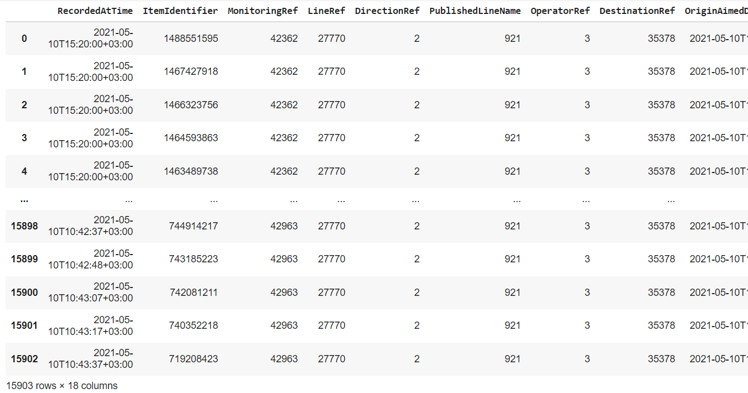

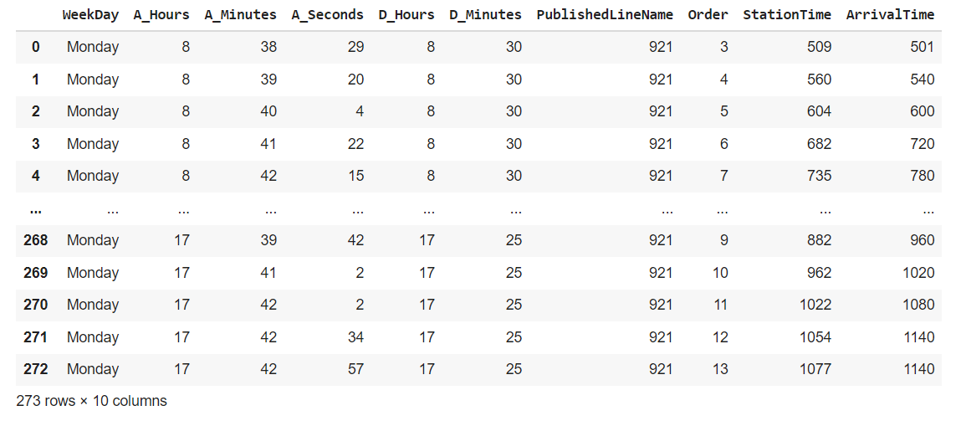
15,903 rows
273 rows

Slide 9
Final Data frame file
From each pulling, we drop non relevant features and left with final data according to our chosen route.

Slide 10

Modeling
XGBoost Regression
XGBoost Clasiefiere

Slide 11
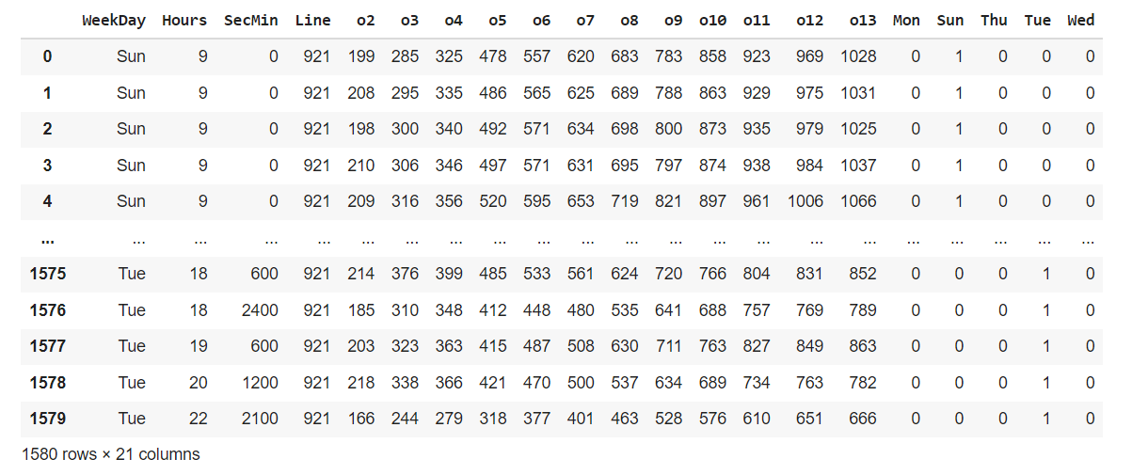
XGBoost Regression Data table

Slide 12


XGBoost Regression: inputs (hours,minSec,line,weekday[ ])
output(sec)
The main idea of the model, that every station which want to predict have previous input data station time
input
Station 2
predicted
input
Station 3
predicted
input
Station 4
predicted
Input data station 2
Input data station 3

Slide 13
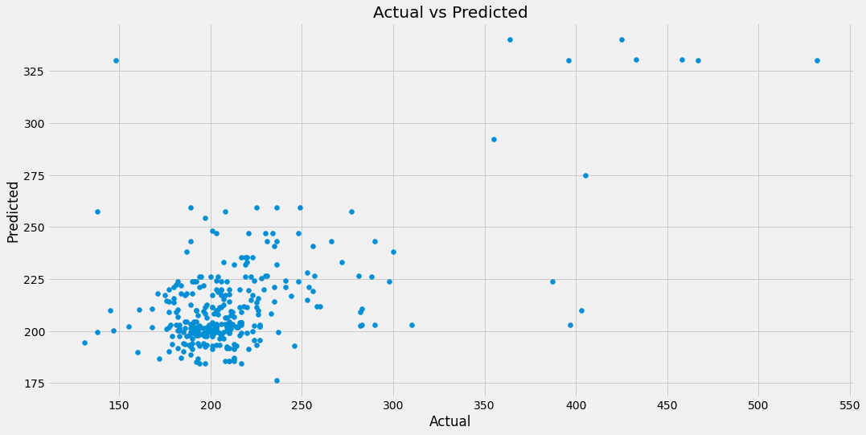
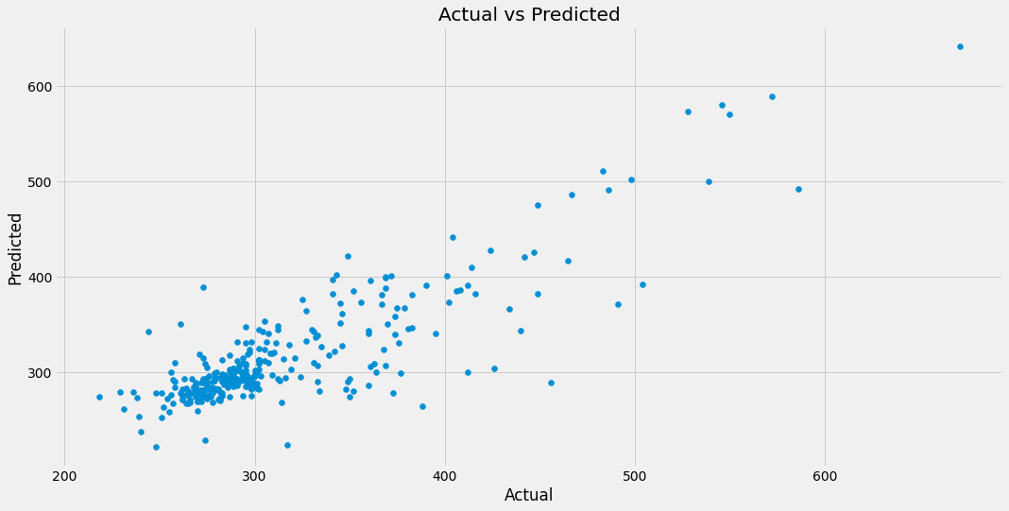
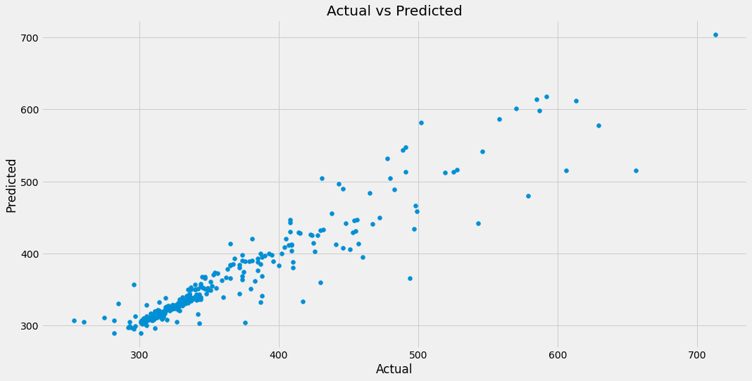
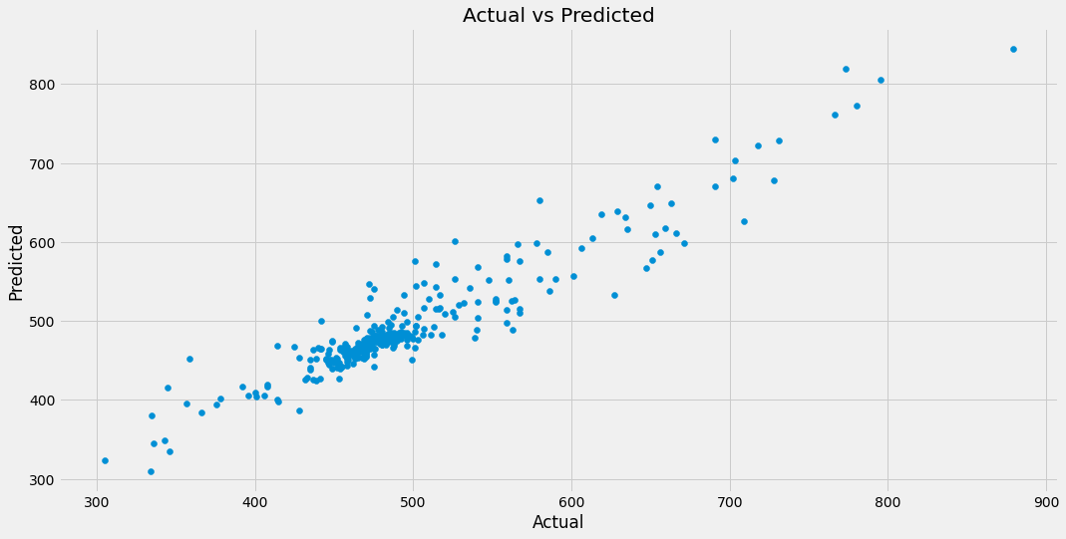
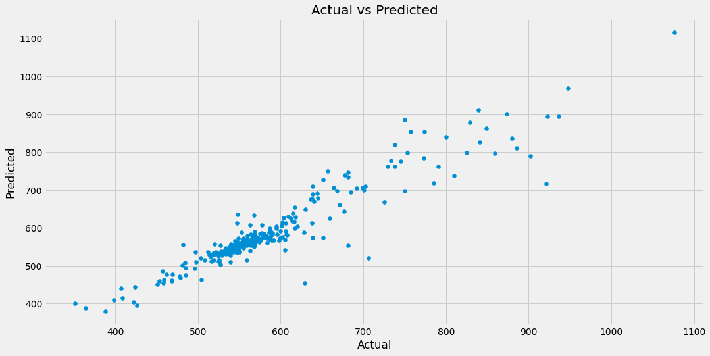
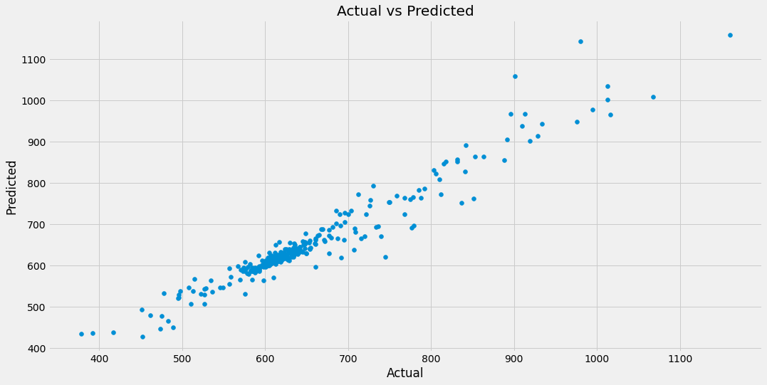
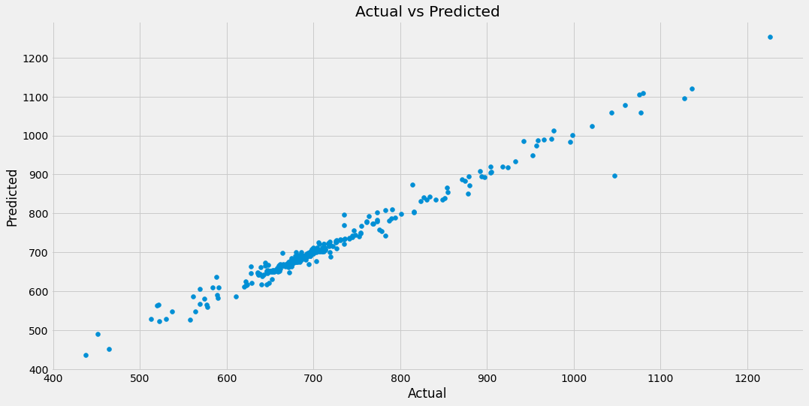

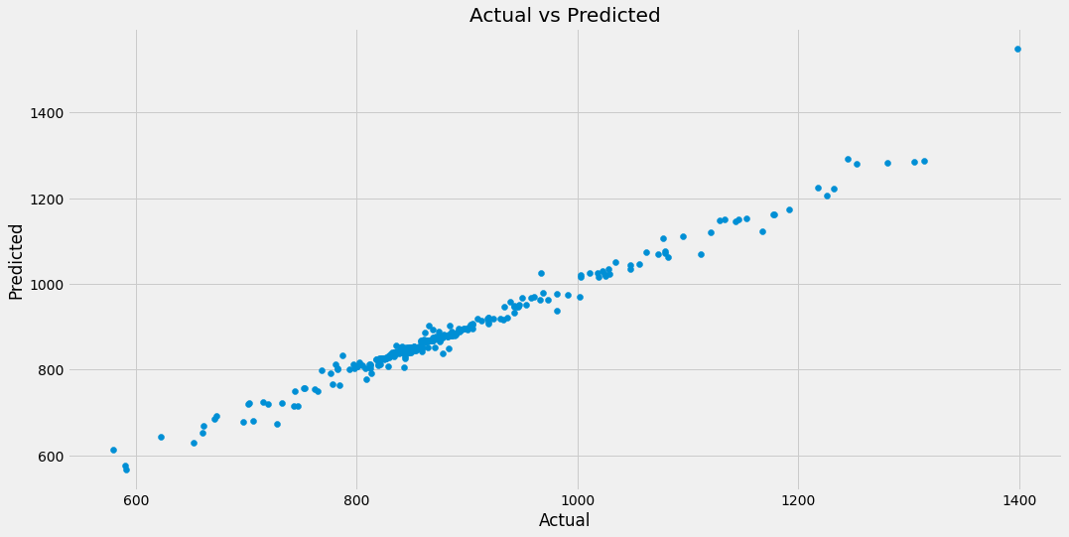
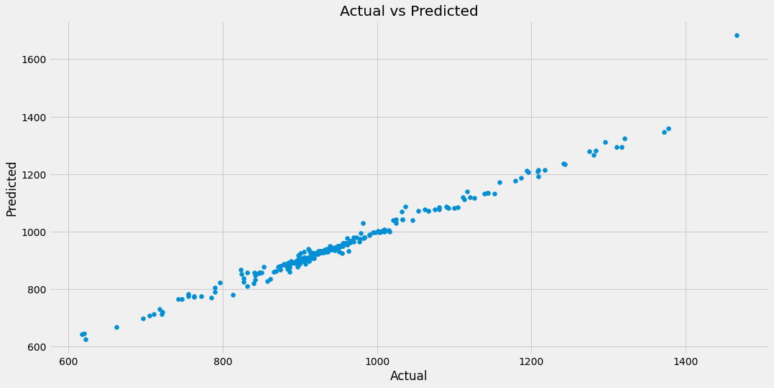
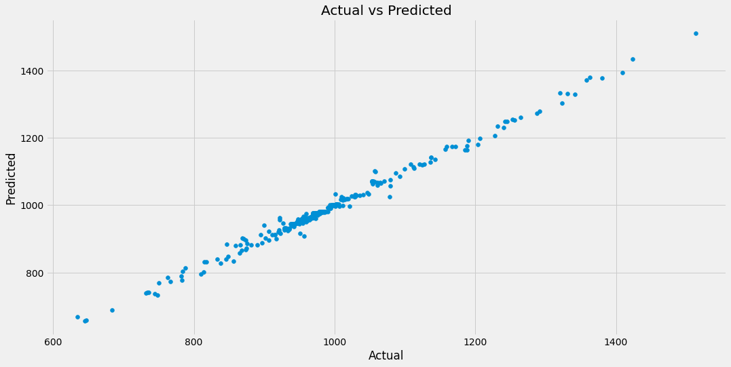
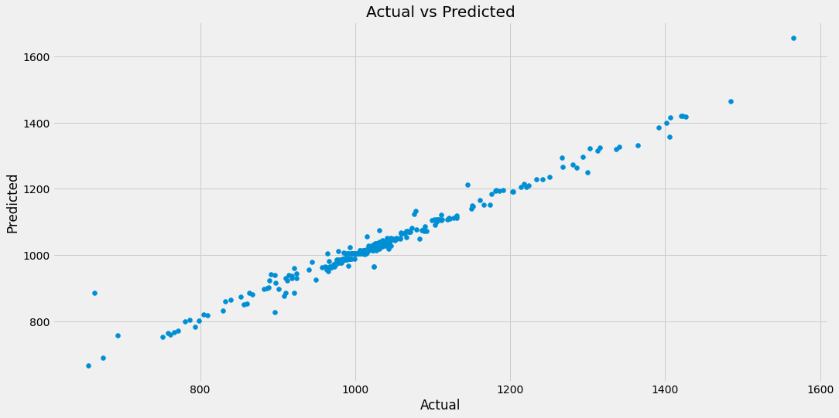
Results of the Model:

Slide 14
 |  |  | Model Statistic data information with weekday
 | Station 2 | Station 3 | Station 4 | Station 5 | Station 6 | Station 7 | Station 8 | Station 9 | Station 10 | Station 11 | Station 12 | Station 13
R^2 | 0.39 | 0.73 | 0.89 | 0.9 | 0.9 | 0.94 | 0.97 | 0.98 | 0.98 | 0.98 | 0.99 | 0.97
RMSE | 38.2 | 33.6 | 23 | 24 | 31 | 25 | 16 | 14 | 14 | 16 | 10 | 20
The statistic Data: difference between y-test to predicted
Min | -202 | -116 | -112 | -69 | -91 | -169 | -68 | -71 | -139 | -217 | -44 | -223
Max | 196 | 166 | 136 | 90 | 184 | 108 | 136 | 49 | 60 | 32 | 58 | 67
STD | 23 | 22 | 12 | 15 | 18 | 15 | 9 | 9 | 8 | 7 | 7 | 10
Average | 38.2 | 33.6 | 23 | 24 | 31 | 25 | 16 | 14 | 14 | 16 | 10 | 20
Hypothesis Accuracy for Tuesday 11:25 |  |  |  |  |  |  |  | Hypothesis Accuracy for Tuesday 16:45
H0 | 81% |  |  |  |  |  |  | H0 | 81%
H1 | 19% |  |  |  |  |  |  | H1 | 19%
Hypothesis Accuracy for whole days |  |  |  |  |  |  |  | Hypothesis Accuracy for whole days
H0 | 91% |  |  |  |  |  |  | H0 | 79%
H1 | 9% |  |  |  |  |  |  | H1 | 21%
 |  |  |  |  | Predicted Data
11:25 | 190 | 265 | 307 | 449 | 528 | 586 | 652 | 752 | 826 | 893 | 943 | 987
16:45 | 256 | 416 | 451 | 628 | 758 | 866 | 938 | 1031 | 1107 | 1167 | 1198 | 1269
 |  |  |  |  | Actual Data H0
11:25 | 182 | 252 | 292 | 437 | 513 | 574 | 638 | 745 | 822 | 886 | 931 | 975
16:45 | 243 | 387 | 428 | 613 | 757 | 834 | 899 | 999 | 1072 | 1137 | 1184 | 1232
 |  |  |  |  | Actual Data H1
11:25 | 177 | 248 | 298 | 353 | 400 | 446 | 489 | 572 | 634 | 676 | 701 | 752
16:45 | 247 | 333 | 366 | 587 | 650 | 746 | 854 | 941 | 996 | 1037 | 1092 | 1113

Slide 15
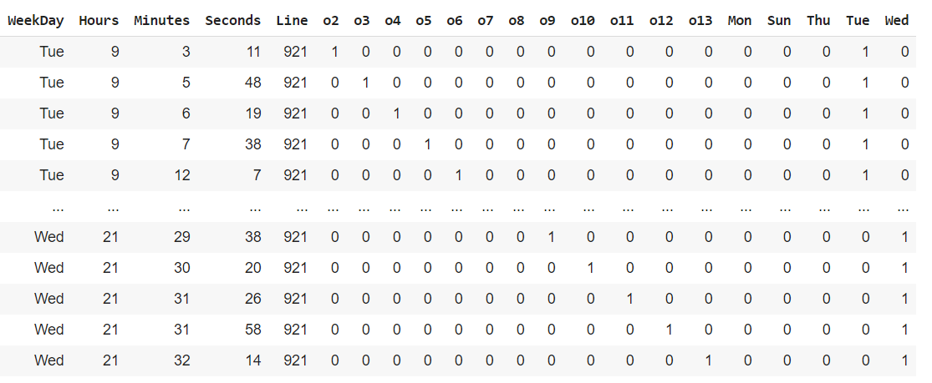
XGBoost Classifier: inputs(hours, minutes, line, weekday)
output(1 or 0)

Slide 16
THE PROCESS
Inputs: hours, minutes, seconds, line
Outputs: 0 or 1 (12 Model Station)
WeekDays transform to dummy var
Each output model insert to the list
Function with inputs: hours, minutes, line, station
Function manipulation
Function return predicted df (hour, minutes, seconds, line, station)

Slide 17
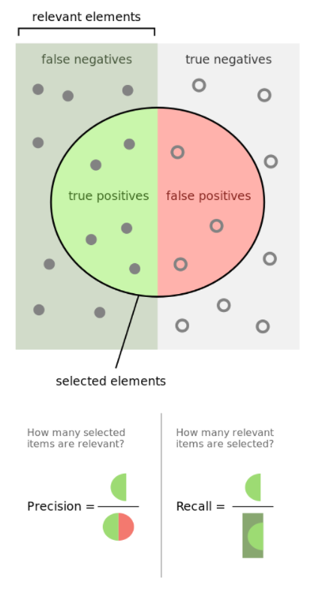
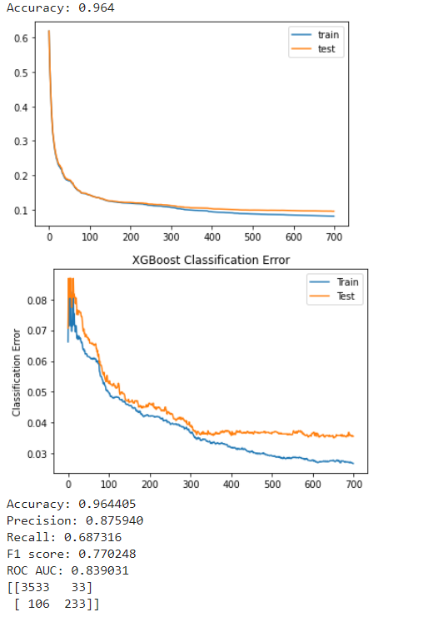
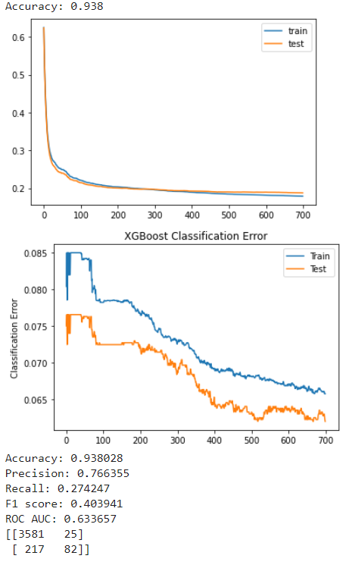
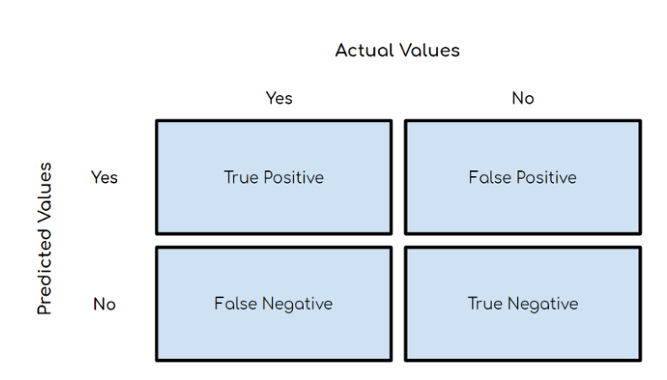

Slide 18
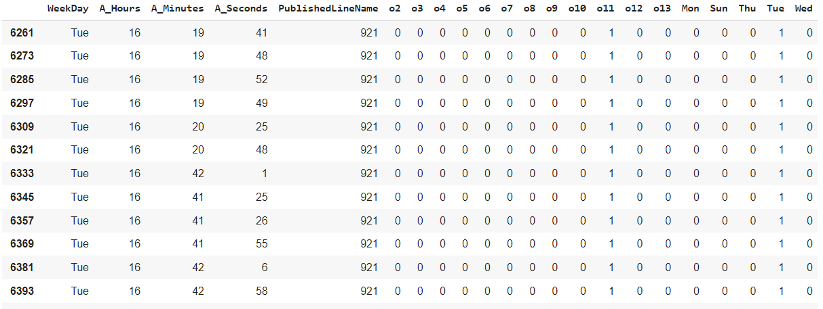
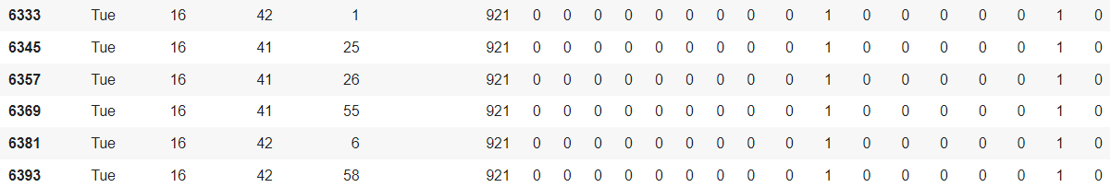

Original Data:
Predicted:

Slide 19
Conclusion
- If we had 3 month, we would try to predict the bus late departure from first station
- If we had 3 month more we will continue to work with WAZE API and build the own model with this kind of the feature.

Slide 20
Thank you
Oleg Shamray

